Slide 1
Return On Investment (ROI) Infographics

Slide 2



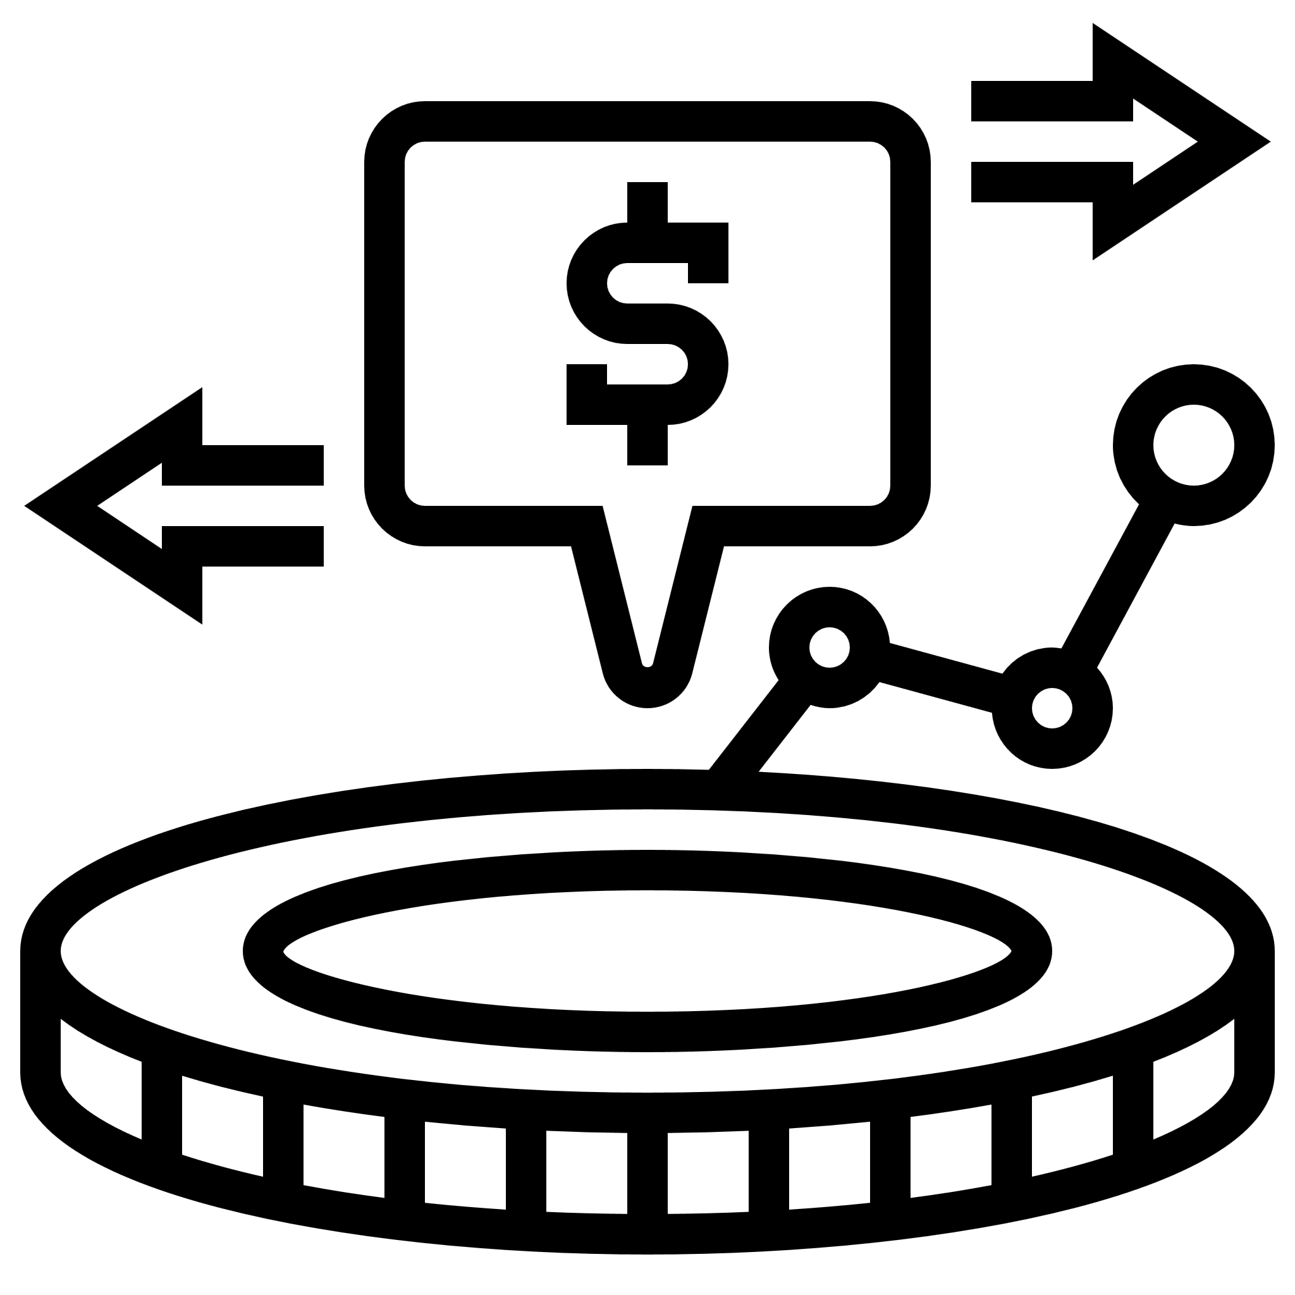




Return On Investment (ROI) Infographics
Capital
Investment
Sales
Return
Return On Investment
Interest Calculation
Measure
Progress
Success

Slide 3
Return On Investment (ROI) Infographics
Engagement
Influence
Maecenas non laoreet odio. Fusce lobortis porttitor purus.
Maecenas non laoreet odio. Fusce lobortis porttitor purus.
Engagement
Influence
Exposure
Action
Maecenas non laoreet odio. Fusce lobortis porttitor purus.
Maecenas non laoreet odio. Fusce lobortis porttitor purus.
Exposure
Action
Return On Investment
Maecenas non laoreet odio. Fusce lobortis porttitor purus.

Slide 4






Return On Investment (ROI) Infographics
Sales
RIO =
Gain from Investment
Cost of investment
Success
Capital
Your Sample Text Here
Maecenas non laoreet odio. Fusce lobortis porttitor purus. Mecenas non laoreet odio. Fusce lobortis porttitor purus.
Maecenas non laoreet odio. Fusce lobortis porttitor purusMaecenas non laoreet odio. Fusce lobortis porttitor purus..
Return of Investment
Return
Investment
Interest Calculation

Slide 5
Return On Investment (ROI) Infographics
Know Your Options
Make Key Decisions
Add Value
Transfer Leadership
Attract Ideal Buyer
Decision Road Map
Think Like An Investor
Pros & Cons
Financial
Family/Partner
Employees
Growth
Next Act
Value Target
Build Sale Ability Blueprint
Fix Red Flags
Add Green Lights
Mentor Mgmt. Team
Hold Team Accountable
Now You Need An M&A Team
Sell Part Or All For a Premium
Steps To Earn ROI in Business
Maecenas non laoreet odio. Fusce lobortis porttitor purus. Mecenas non laoreet odio. Fusce lobortis porttitor purus.Maecenas non laoreet odio. Fusce lobortis porttitor purusMaecenas non laoreet odio. Fusce lobortis porttitor purus..

Slide 6
Return On Investment (ROI) Infographics
The ROI Model
Planning
Data Collection
Data Analysis
Tabulate Meeting Cost
Reporting
Develop Evaluation
Plans And Baseline Data
Collect Data During Meeting
Collect Data After Meeting Application
Isolate Effects Of Meeting
Convert Data To Monetary Value
Calculate The Return On Investment
Reach Conclusion/ Generate Report
Communicate Information To Target Groups
Satisfaction/ Reaction
Learning
Application/ Implementation
Business Impact
Roi
Identify Intangible Measure
Intangible Benefits

Slide 7
Return On Investment (ROI) Infographics
Maecenas non laoreet odio. Fusce lobortis porttitor purus.
340K
500 hrs
Returns
Investment
+8,000
Maecenas non laoreet odio. Fusce lobortis porttitor purus.
New customers

Slide 8
Return On Investment (ROI) Infographics
Costs
Financial
Maecenas non laoreet odio. Fusce lobortis porttitor purus.
Maecenas non laoreet odio. Fusce lobortis porttitor purus.
Benefits
Non-financial
Benefits
Maecenas non laoreet odio. Fusce lobortis porttitor purus.
Maecenas non laoreet odio. Fusce lobortis porttitor purus.
Costs
$120K
ROI

Slide 9
Return On Investment (ROI) Infographics
Advantages
Can compare large and small units
Easily understood
Compare to interest rates and the rates of returns on alternative investments
Widely used and reported
Return On Investment
Limitations
Goal congruence issues
Might incent managers to make decisions mot in the company’s best interest
Your Sample Text Here
Maecenas non laoreet odio. Fusce lobortis porttitor purus. Mecenas non laoreet odio. Fusce lobortis porttitor purus.Maecenas non laoreet odio. Fusce lobortis porttitor purusMaecenas non laoreet odio. Fusce lobortis porttitor purus..

Slide 10
Return On Investment (ROI) Infographics
ROI formula
Example
Return
Investment
$24,000
$13,000
ROI
ROI
100
$13,000
100
85%
Investment

Slide 11
Return On Investment (ROI) Infographics
Metrics For Social Media ROI
01
02
03
04
Audience Reach
Clicks To Site
Engagement
Conversion Rate
Maecenas non laoreet odio. Fusce lobortis porttitor purus.
Maecenas non laoreet odio. Fusce lobortis porttitor purus.
Maecenas non laoreet odio. Fusce lobortis porttitor purus.
Maecenas non laoreet odio. Fusce lobortis porttitor purus.

Slide 12
Return On Investment (ROI) Infographics
$896 M
+45
Benefits
New investors
Maecenas non laoreet odio. Fusce lobortis porttitor purus.
Maecenas non laoreet odio. Fusce lobortis porttitor purus.
$3.1 B
346
Online sales
New products
Maecenas non laoreet odio. Fusce lobortis porttitor purus.
Maecenas non laoreet odio. Fusce lobortis porttitor purus.

Slide 13
Return On Investment (ROI) Infographics
01
Website ROI calculation process
Traffic
Maecenas non laoreet odio. Fusce lobortis porttitor purus.
03
02
Customers
Leads
Maecenas non laoreet odio. Fusce lobortis porttitor purus.
Maecenas non laoreet odio. Fusce lobortis porttitor purus.

Slide 14
Return On Investment (ROI) Infographics
$23,300
65%
$12,000
1.76
Actual Cost Of Work Performed
Return On Investment
Estimated Cost Variance
Cost Performance Index
Maecenas non laoreet odio. Fusce lobortis porttitor purus.
Maecenas non laoreet odio. Fusce lobortis porttitor purus.
Maecenas non laoreet odio. Fusce lobortis porttitor purus.
Maecenas non laoreet odio. Fusce lobortis porttitor purus.

Slide 15
Return On Investment (ROI) Infographics
Success
01
02
Investment
Maecenas non laoreet odio. Fusce lobortis porttitor purus.
Maecenas non laoreet odio. Fusce lobortis porttitor purus.
Sales
03
ROI
04
Interest
Maecenas non laoreet odio. Fusce lobortis porttitor purus.
Return On Investment
Maecenas non laoreet odio. Fusce lobortis porttitor purus.
Per capita
05
06
Return
Maecenas non laoreet odio. Fusce lobortis porttitor purus.
Maecenas non laoreet odio. Fusce lobortis porttitor purus.

Slide 16
Return On Investment (ROI) Infographics
01
Simple ROI Calculation
(Total Revenue - Marketing Investment)
X 100
Marketing Investment
02
Accurate ROI Calculation
(Total Revenue -Total COGS - Marketing Investment)
X 100
Marketing Investment

Slide 17
Return On Investment (ROI) Infographics
01
Cost
Maecenas non laoreet odio. Fusce lobortis porttitor purus.
02
Benefit
ROI
Maecenas non laoreet odio. Fusce lobortis porttitor purus.
03
Time
Maecenas non laoreet odio. Fusce lobortis porttitor purus.

Slide 18
Return On Investment (ROI) Infographics
01
Pageviews
Maecenas non laoreet odio. Fusce lobortis porttitor purus.
02
Social interactions
Maecenas non laoreet odio. Fusce lobortis porttitor purus.
03
Links from high value sites
ROI Measurement For Infographics
Maecenas non laoreet odio. Fusce lobortis porttitor purus.
04
Search engine rank
Maecenas non laoreet odio. Fusce lobortis porttitor purus.
05
Direct leads
Maecenas non laoreet odio. Fusce lobortis porttitor purus.

Slide 19
Return On Investment (ROI) Infographics
ROI model
Evaluation
Practice
Process
Operation
Implement
Maecenas non laoreet odio. Fusce lobortis porttitor purus.
Maecenas non laoreet odio. Fusce lobortis porttitor purus.
Maecenas non laoreet odio. Fusce lobortis porttitor purus.
Maecenas non laoreet odio. Fusce lobortis porttitor purus.
Maecenas non laoreet odio. Fusce lobortis porttitor purus.

Slide 20
Return On Investment (ROI) Infographics
Social Media ROI
25%
50%
Audience Reach
Engagement
Maecenas non laoreet odio. Fusce lobortis porttitor purus.
Maecenas non laoreet odio. Fusce lobortis porttitor purus.
30%
40%
Clicks To Site
Conversion Rate
Maecenas non laoreet odio. Fusce lobortis porttitor purus.
Maecenas non laoreet odio. Fusce lobortis porttitor purus.

Slide 21
Return On Investment (ROI) Infographics
Time
Cost
Maecenas non laoreet odio. Fusce lobortis porttitor purus.
Maecenas non laoreet odio. Fusce lobortis porttitor purus.
ROI
Maecenas non laoreet odio. Fusce lobortis porttitor purus.
Gain From Investment
Cost Of Investment

Slide 22
Return On Investment (ROI) Infographics
Action
04
01
Exposure
Maecenas non laoreet odio. Fusce lobortis porttitor purus.
Maecenas non laoreet odio. Fusce lobortis porttitor purus.
Four Stages ROI Model
Influence
03
02
Engagement
Maecenas non laoreet odio. Fusce lobortis porttitor purus.
Maecenas non laoreet odio. Fusce lobortis porttitor purus.

Slide 23
Return On Investment (ROI) Infographics
01
02
03
Absolute Returns
Annualized Returns
Total Returns
Maecenas non laoreet odio. Fusce lobortis porttitor purus.
Maecenas non laoreet odio. Fusce lobortis porttitor purus.
Maecenas non laoreet odio. Fusce lobortis porttitor purus.
6 Types Of Returns
04
05
06
Point To Point Returns
Trailing Returns
Rolling Returns
Maecenas non laoreet odio. Fusce lobortis porttitor purus.
Maecenas non laoreet odio. Fusce lobortis porttitor purus.
Maecenas non laoreet odio. Fusce lobortis porttitor purus.

Slide 24
Return On Investment (ROI) Infographics
 | Investment | Benefits | ROI
Action A | $1,000 | $3,000 | 2
Action B | $1,000 | $1,500 | 0.5
Action A+B | $2,000 | $4,500 | 1.25

Slide 25
Return On Investment (ROI) Infographics
4 Types Of ROI
01
02
03
04
ROI
ROO
ROE
ROA
Return On Investment
Return On Objectives
Return On Engagement
Return On Acquisition

Slide 26
Return On Investment (ROI) Infographics
Marketing Investment
Cost Per Thousand (CPM)
Cost Per Click (CPC)
ROI Formula
Cost Per Lead (CPL)
(Total Revenue - Marketing Investment)
Cost Per Action (CPA)
X 100
Marketing Investment
Return On Investment

Slide 27
Return On Investment (ROI) Infographics
Stage
Four stages ROI model
04
Action
Maecenas non laoreet odio. Fusce lobortis porttitor purus.
Stage
03
Influence
Maecenas non laoreet odio. Fusce lobortis porttitor purus.
Stage
02
Engagement
Maecenas non laoreet odio. Fusce lobortis porttitor purus.
Stage
01
Exposure
Maecenas non laoreet odio. Fusce lobortis porttitor purus.

Slide 28
Return On Investment (ROI) Infographics
5 Steps Before Measuring Campaign ROI
01
Define Goals
02
Maecenas non laoreet odio. Fusce lobortis porttitor purus.
Use The Right Tools
Maecenas non laoreet odio. Fusce lobortis porttitor purus.
03
Integrate Channels
04
Maecenas non laoreet odio. Fusce lobortis porttitor purus.
Life Cycle Value
Maecenas non laoreet odio. Fusce lobortis porttitor purus.
05
Multi-Wave Campaign
Maecenas non laoreet odio. Fusce lobortis porttitor purus.

Slide 29
Return On Investment (ROI) Infographics
Maecenas non laoreet odio. Fusce lobortis porttitor purus.
Maecenas non laoreet odio. Fusce lobortis porttitor purus.
Maecenas non laoreet odio. Fusce lobortis porttitor purus.
$360
$60
500%
$5
100
$60
Maecenas non laoreet odio. Fusce lobortis porttitor purus.
Maecenas non laoreet odio. Fusce lobortis porttitor purus.
Maecenas non laoreet odio. Fusce lobortis porttitor purus.

Slide 30
Return On Investment (ROI) Infographics
Revenue Increase
Gross margin
Jupiter is a gas giant and the biggest planet
Mercury is the closest planet to the Sun
Annual Cost
ROI dollars
Neptune is the farthest planet from the Sun
Despite being red, Mars is really a very cold place
$127,980
Return on investment

Slide 31
Icons

Slide 32
Icons

Slide 33
How To Edit Shapes
You can add and edit some shapes to your presentation to present your data in a visual way.
Choose your favourite infographic and insert it in your presentation using Ctrl C + Ctrl V or Cmd C + Cmd V in Mac.
Select one of the parts and ungroup it by right-clicking and choosing “Ungroup”.
Change the color by clicking on the paint bucket.
Then resize the element by clicking and dragging one of the square-shaped points of its bounding box (the cursor should look like a double-headed arrow). Remember to hold Shift while dragging to keep the proportions.
Group the elements again by selecting them, right-clicking and choosing “Group”.
Repeat the steps above with the other parts and when you’re done editing, copy the end result and paste it into your presentation.
Remember to choose the “Keep source formatting” option so that it keeps the design. For more info, please visit Slideegg (Tips & Tricks).

Slide 34
Terms Of Use (Free Users)
If you are a free subscriber, you should credit SlideEgg by keeping the “Thank You” slide.
Kindly refer to the following slide for the Terms of Use for premium users.
You can:
Customize or edit this template
Use this template for both business and personal endeavors.
You can not:
Sell, rent, or second-license SlideEgg content or its altered version. Promulgate, unless explicitly permitted, SlideEgg content, by SlideEgg.
Incorporate SlideEgg content in any database or file online or offline.
Obtain SlideEgg content’s copyright.
Kindly refer to our Tutorial page or FAQ for advanced slide modification guidelines.

Slide 35
Terms Of Use (Premium Users)
Being a premium subscriber, you have the privilege of using this PPT template
without giving attribution to SlideEgg or keeping the “Thank You” slide.
You can:
Customize or edit this template.
Use this template for both business and personal endeavors.
Circulate or share the editable format of this template with anyone you want.
You can not:
Sell, rent or second-license SlideEgg content or the altered version of it. Promulgate or include the templates in any other services database
that performs as distribution or resale platform, unless explicitly permitted, by SlideEgg.
Incorporate the elements used in SlideEgg’s templates separately.
Obtain SlideEgg’s copyright for the elements used in this template as a logo or trademark.
Kindly refer to our Tutorial page or FAQ for advanced slide modification guidelines.

Slide 36





Thank You!
We respect your valuable time with SlideEgg!
If you have any questions, please reach us
Do you have a design request, please visit our redesign page.
CREDIT: SlideEgg created this PowerPoint template.
Let this slide be kept for attribution.
www.slideegg.com

